Slide 1
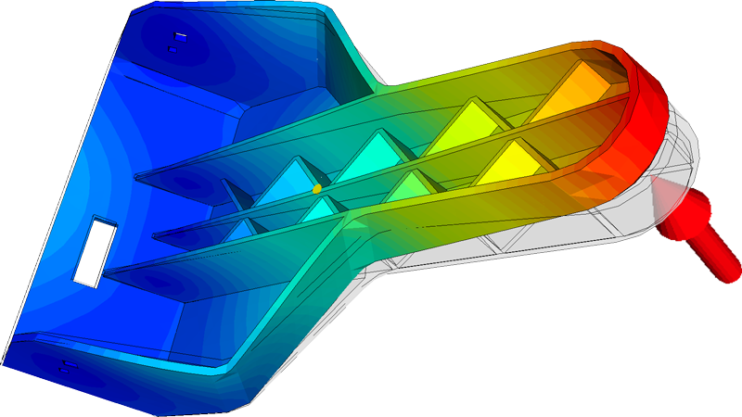
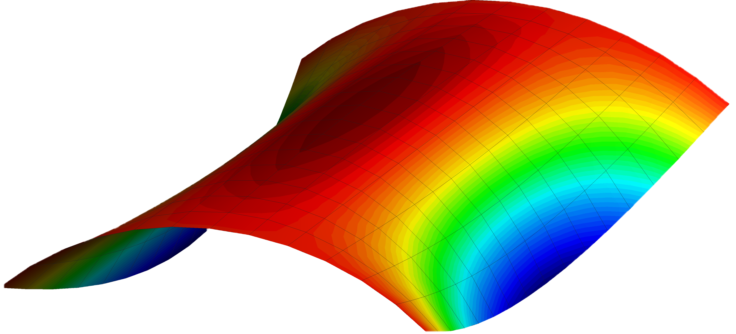
FINITE ELEMENT ANALYSIS
How Materials bend, and why? Showcased and analyzed with Python, Final Project by Youssef El Gharably.
Franklin and Marshall College Spring 2024 PHY226

Slide 2
Goals and Motivation:
Exploring how a beam bends with different loads and forces
Exploring the factors that affect how much a beam bends
Exploring how such a problem could be modeled as differential equations, then using tools from lab to solve them.

Slide 3
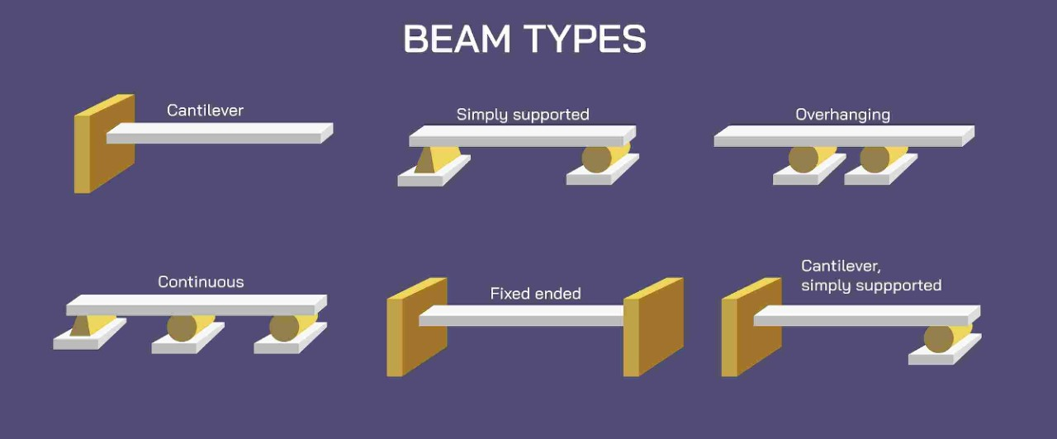
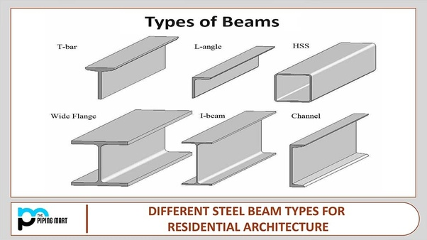
What’s a beam?
“Beams and columns are two important types of structural elements that play a key role in creating a safe load path to transfer the weight and forces on a structure to the foundations and into the ground.”
https://structuralengineeringbasics.com/what-are-beams-and-columns-building-construction/

Slide 4
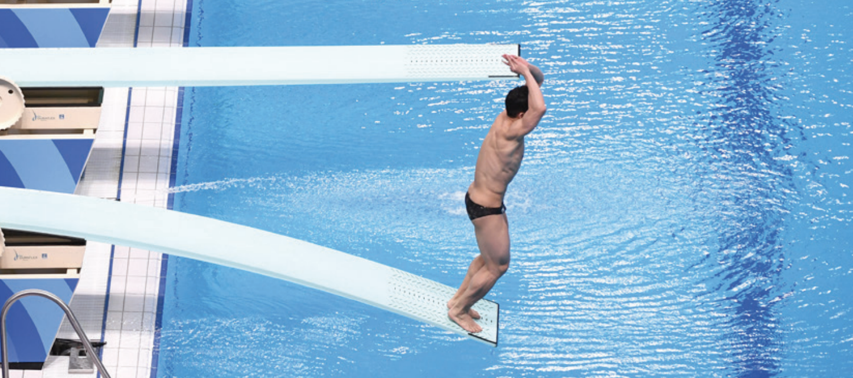
Diving boards ~ Cantilevered Beams

Slide 5
Diving boards ~ Cantilevered Beams
Bending ~ Deflection

Slide 6
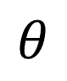
Diving boards ~ Cantilevered Beams
$$θ$$
Bending ~ Deflection

Slide 7
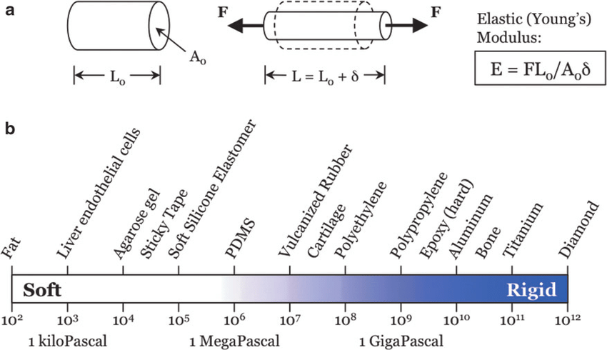
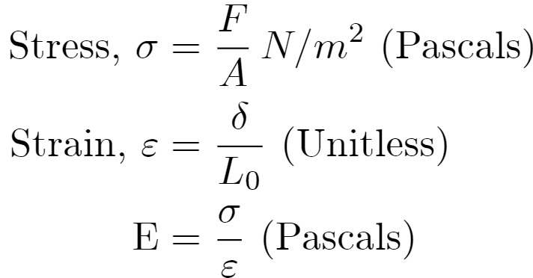
What makes something Stretchy and/or Bendy?

Slide 8
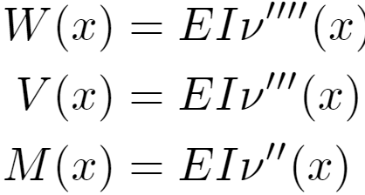
Some background info
By knowing how much weight is present on a certain material for every x position, you’re able to integrate it to get the shear force, and the moment (torque) about that position.
“E” → Young’s Modulus, the ratio between the stress and the strain of a certain material. This is constant depending on the material standard type

Slide 9
Some background info
“I” → The Area Moment of Inertia, sometimes referred to as the second moment of inertia. It’s a property for any solid material that depends on its sectional area, and area distribution.
More on I in the next slide

Slide 10
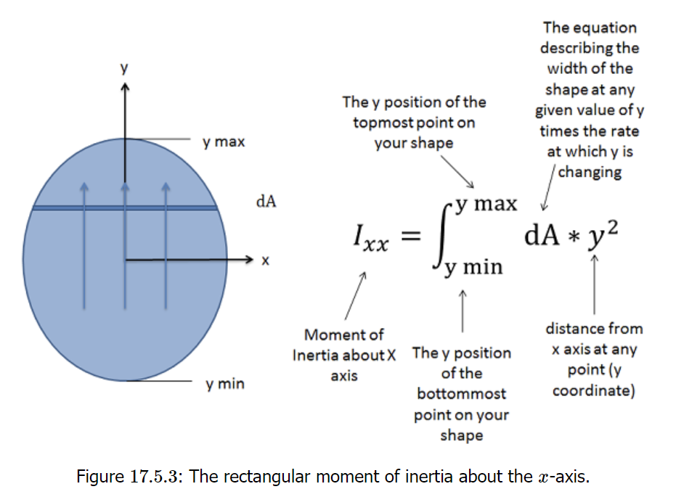
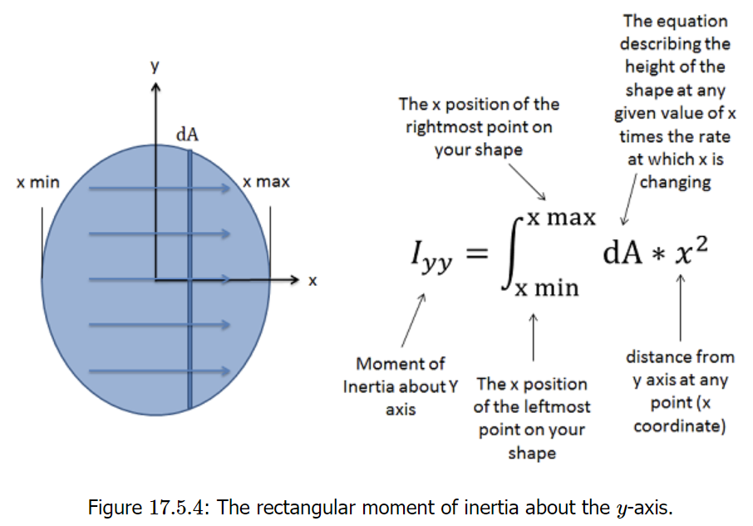
Figures via Engineering Libretexts 17.5

Slide 11
Some background info
“ν(x)” → This is our deflection operator, the main thing this project is focused on.
ν’(x) → Slope of Defection
ν(x) → Magnitude of Deflection
RK4 was used to integrate these lovely differential equations ☺

Slide 12
Some Assumptions and Standardizations for this project: (This project is only based on diving boards)
No Bending! v(0) = 0, v’(0) =0
Bending ~ Deflection

Slide 13
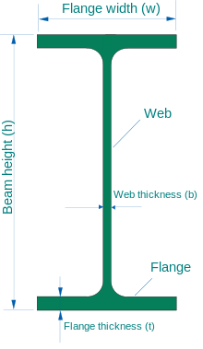
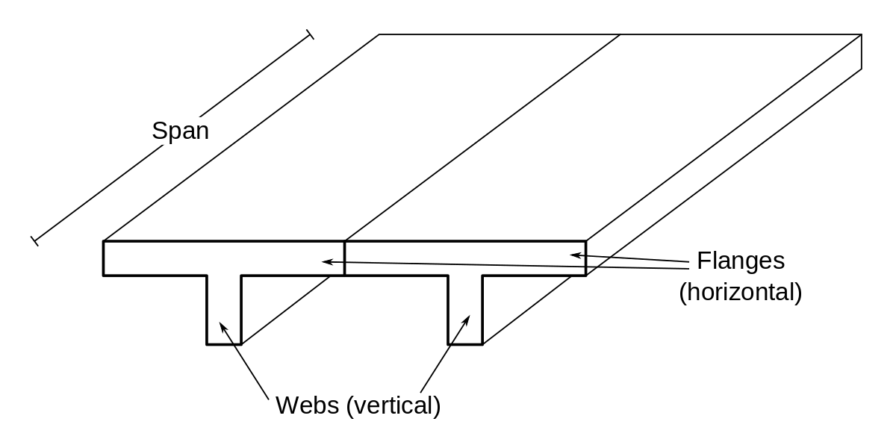
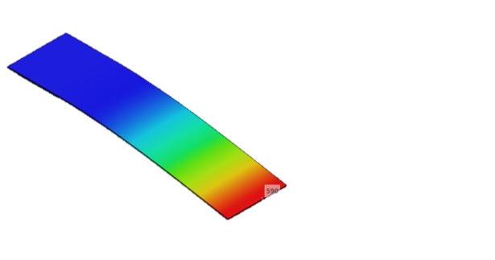
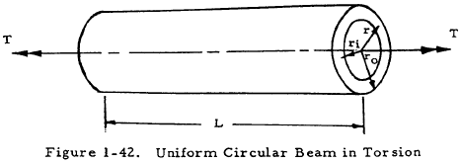
Some Assumptions and Standardizations for this project: (We’ve got 4 types of beams!)

Slide 14
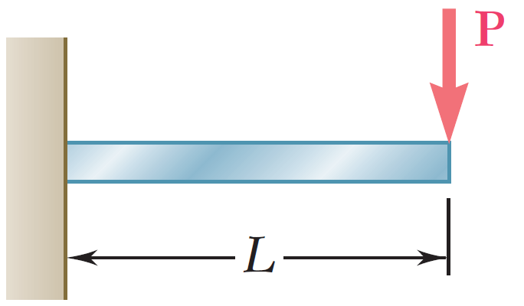
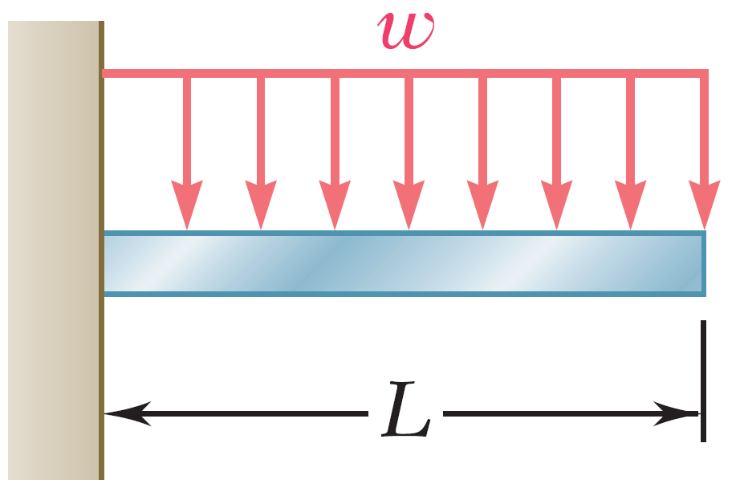
Some Assumptions and Standardizations for this project: (We’ve got 2 types of loads)
Point Force Load (better simulation of divers)
Uniformly Distributed Loads

Slide 15
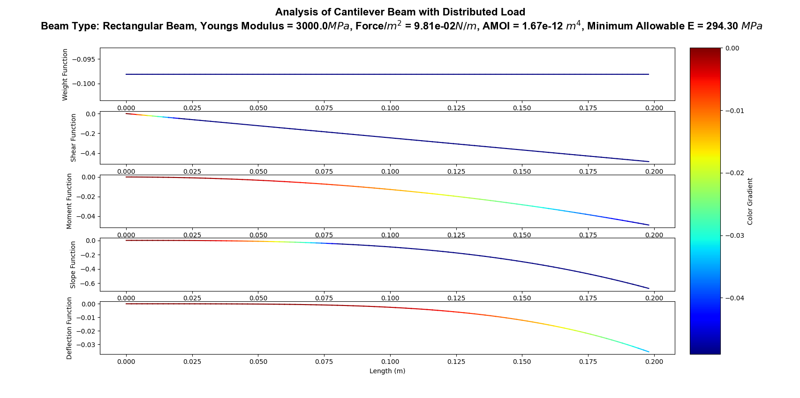
Uniform Weight of flexy thin 3D Print, h = 0.2mm

Slide 16
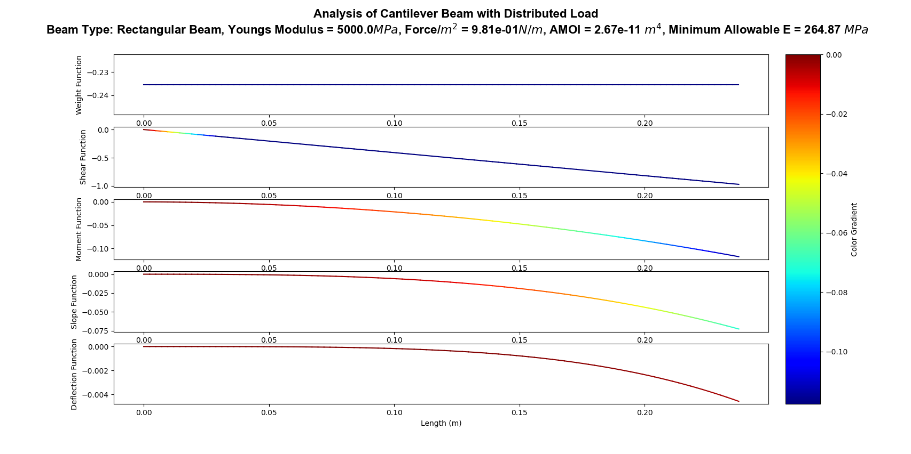
Uniform Weight Green 3D Print, h = 2mm

Slide 17
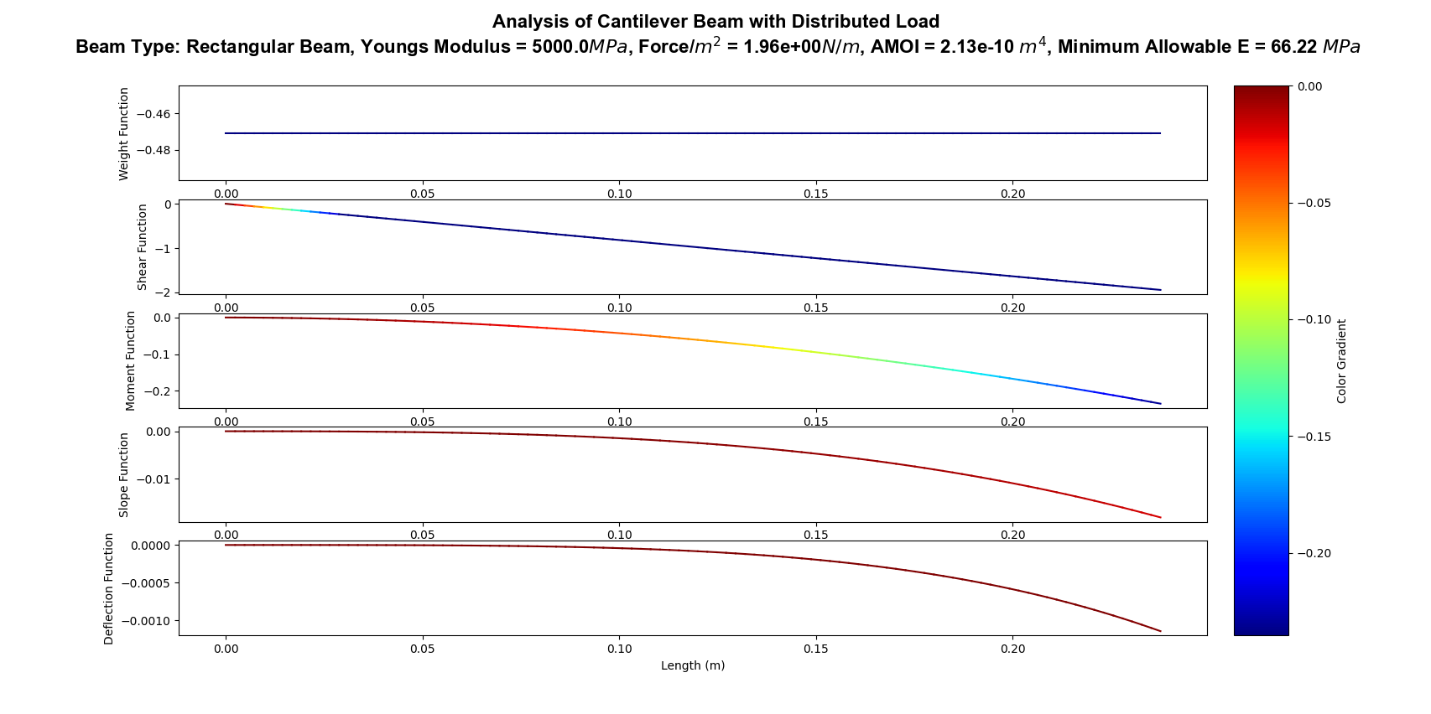
Uniform Weight Green 3D Print, h = 4mm

Slide 18

Uniform Weight Green 3D Print, h = 8mm

Slide 19
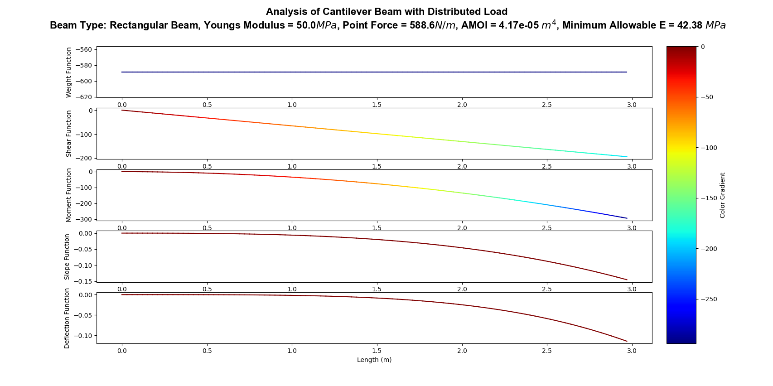
Uniform Simulation of a very heavy diving board (terrible diving board)

Slide 20
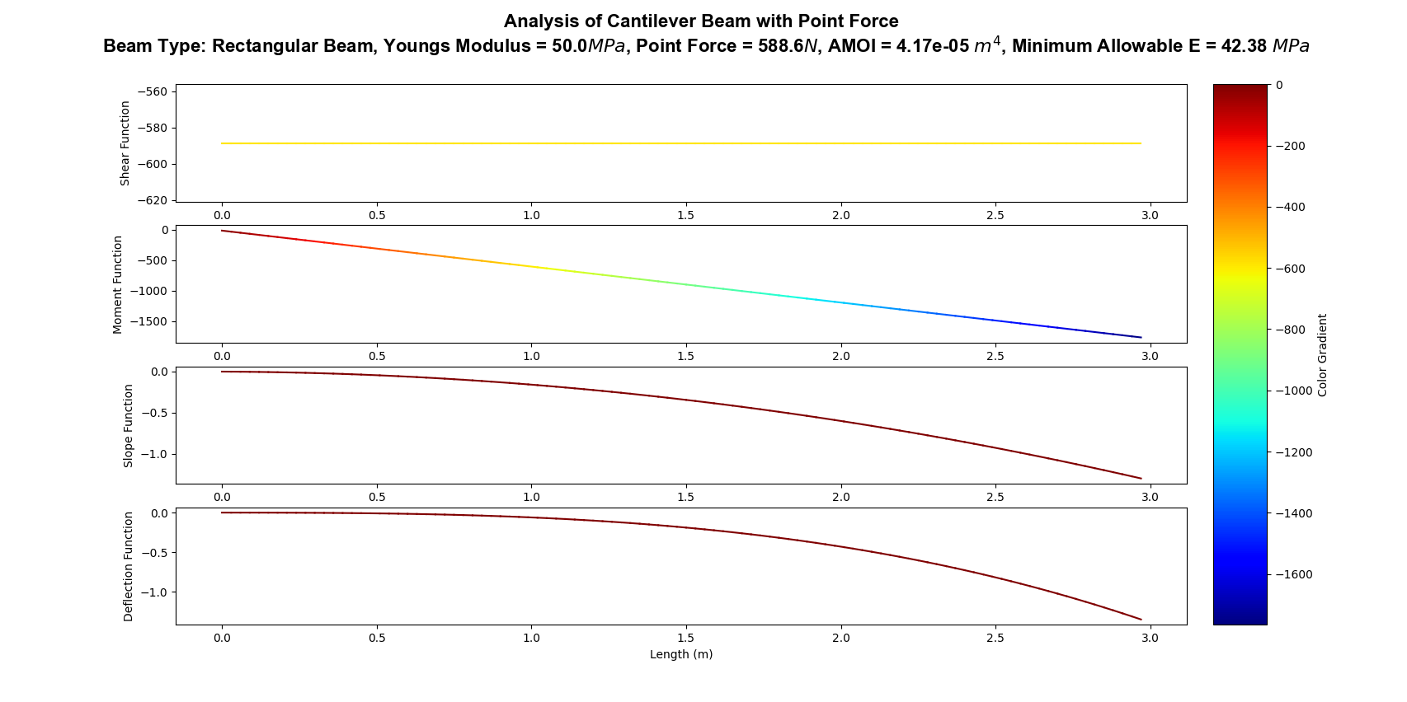
Simulation of a diver on the edge

Slide 21
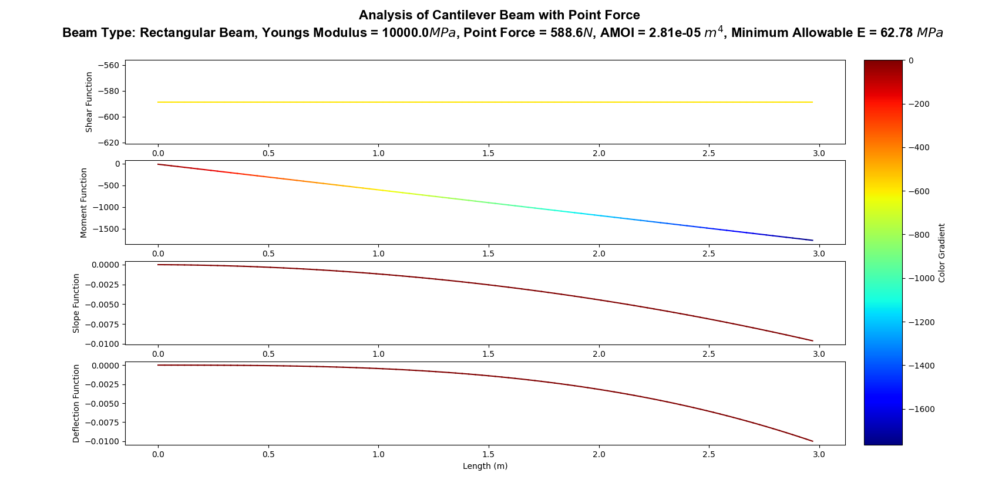
Simulation of Rectangular Solid Diving Board

Slide 22
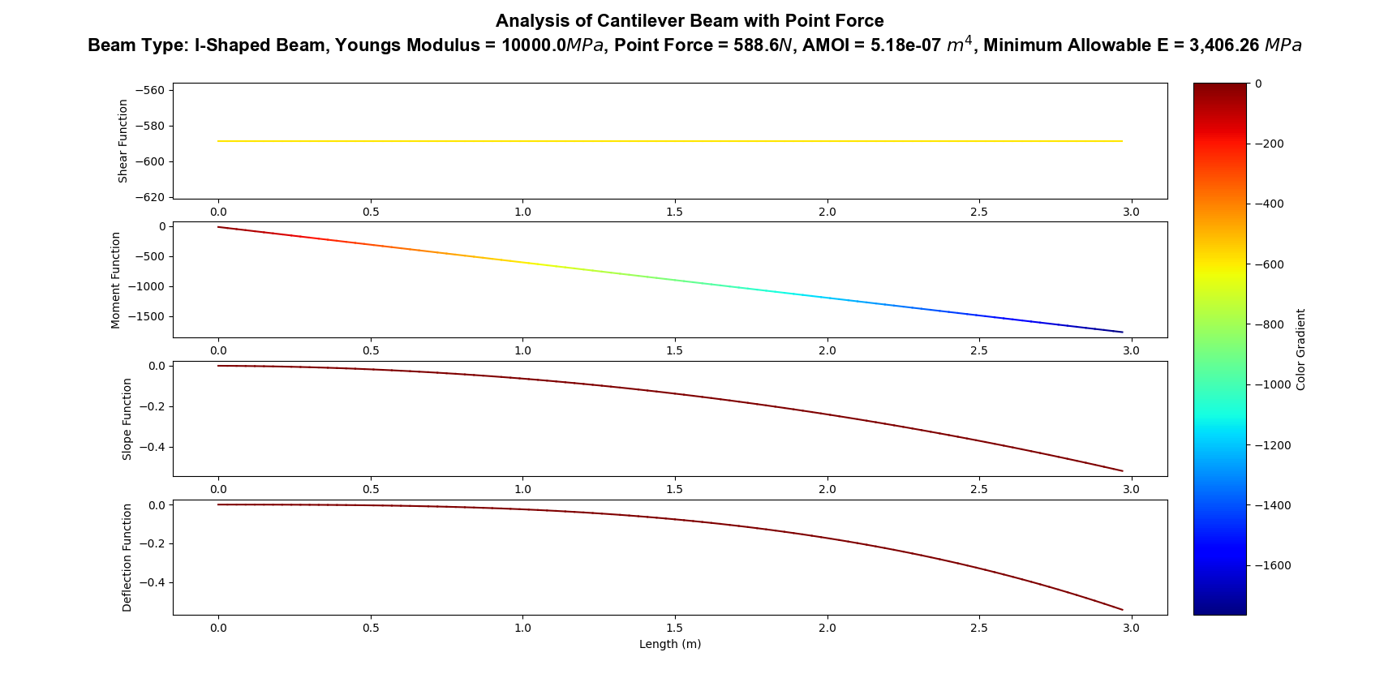
Simulation of I-Shaped Solid Diving Board

Slide 23

Simulation of T-Shaped Solid Diving Board

Slide 24

Simulation of Cylinder-Shaped Solid Diving Board

Slide 25

Minimum Allowable Youngs Modulus

Slide 26
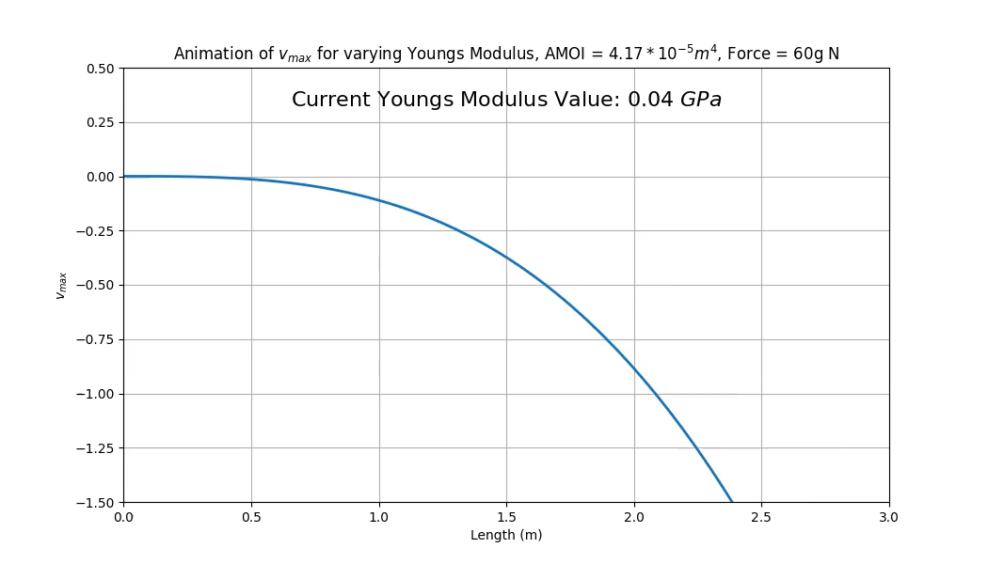

Slide 27
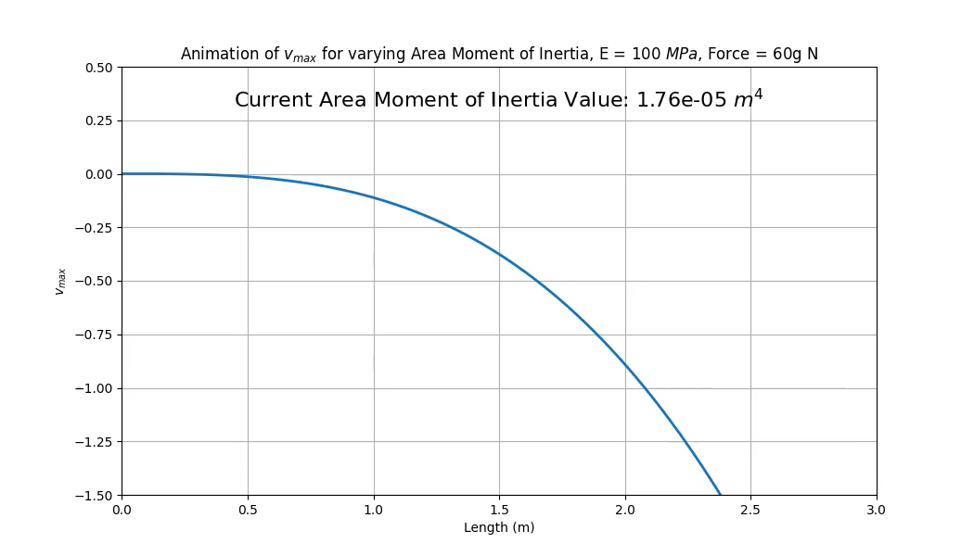

Slide 28
Finite element analysis isn’t typically made with python, but it’s always fun to try! Thanks for listening ☺

